Slide 1
Web Engineering
Introduction to Javascript
Lecture 07

Slide 2
What is JavaScript?
A programming language specifically designed to work with Web browsers
It is designed to be used for developing small programs – called scripts – that can be embedded in HTML Web pages
JavaScript:
Is an interpreted language
Supports event-driven programming
Is object-based language

Slide 3
HTML
CSS
JavaScript
markup language
style sheet language
programming language
content
presentation
behavior

Slide 4
Advantages of Client-Side Scripting
Reduced server load as it does not have to send messages to the user’s browser about missing or incorrect data
Reduced network traffic as the form’s data is sent only once instead of many to’s and fro’s

Slide 5
Disadvantages
Client-side scripts do not work with all browsers
Some user intentionally turn scripting off or disabled on their browsers
This increases the complexity of the Web page, as it now has to support both situations: browsers with scripting capability, and those not having that capability

Slide 6
Some of things that JavaScript cannot do!
The following file ops. on the client computer:
Read -- Modify
Rename -- Delete
Create
Create graphics (although, it does have the ability to format pages through HTML - including the placement of graphics)
Any network programming bar one function: the ability to download a file to the browser specified through an arbitrary URL
There is no works in JavaScript to talk with a database.
You can’t access hardware (USB, etc)

Slide 7
Some of the things that JavaScript can do!
Control the appearance of the browser.
Control the content and appearance of the document displayed in the browser
Interact with the user through event handlers
Arbitrary calculations, including floating-point ones
Store & modify a limited amount of data about the user in the form of client-side “cookies”

Slide 8
Case Sensitivity
HTML is not case sensitive. The following mean the same to the browser:
<HTML> -- <html>
<Html> -- <htMl>
JavaScript is case sensitive. Only the first of the following will result in the desired function – the rest will generate an error or some other undesirable event:
onMouseClick -- OnMouseClick
onmouseclick -- ONMOUSECLICK
alert(“hello world”);
Alert(“hello world”);

Slide 9
Referring to a Property
dot
objectName.propertyName
Examples:
window.width
button.value

Slide 10
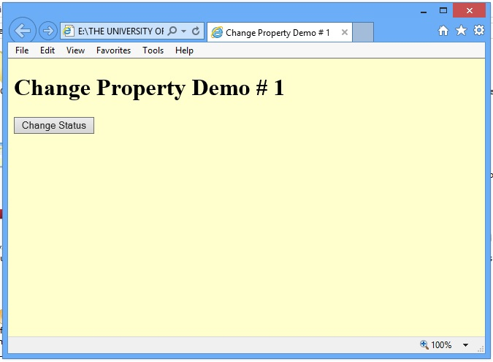

Slide 11
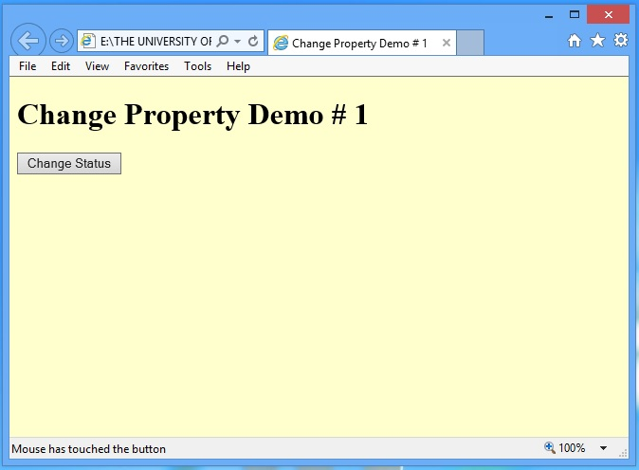

Slide 12
<HTML> <HEAD> <TITLE>Change Property Demo # 1</TITLE> <SCRIPT type=“text/JavaScript”> function changeStatus() { window.status = “Mouse has touched the button”; } </SCRIPT> </HEAD> <BODY> <H1>Change Property Demo # 1</H1> <FORM name=“dummy” method=“” action=“”> <INPUT type=“submit” name=“” value=“Change Status“ onMouseOver=“changeStatus()”> </FORM> </BODY> </HTML>

Slide 13
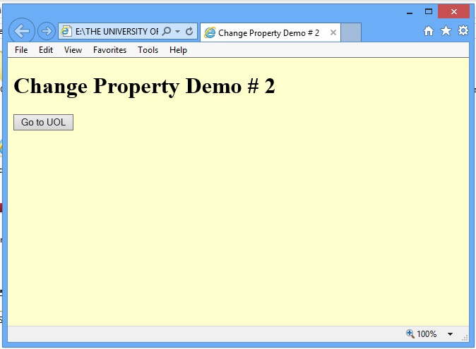

Slide 14


Slide 15
The main code segment that goes between the <SCRIPT>, </SCRIPT> tags in the HEAD:
function gotoURL() { window.location=“http://www.uol.edu.pk/”; }
The JavaScript code included as an attribute of the “Go to UOL” button:
onMouseOver=“gotoURL()”
new value
property

Slide 16
Predefined JavaScript Objects
Anchor | Applet | Area | Array
Boolean | Button | Checkbox | Date
Document | Event | Fileupload | Form
Frame | Function | Hidden | History
Image | Layer | Link | Location
Math | Mimetype | Navigator | Number
Object | Option | Password | Plugin
Radio | RegExp | Reset | Screen
Select | String | Submit | Text
Textarea | window

Slide 17
Methods: Functions (code, instructions, behavior) associated with objects
Methods are functions associated with an object that can be used to manipulate that object
Example:
window.close()
Here “close()” is a method that has been defined for the “window” object. Its function is to close the “window”

Slide 18
Referring to a Method
dot
objectName.methodName( argumnets )
Examples:
window.close()
button.click()
Info is passed on to the method through one or more arguments

Slide 19
A few more methods associated with the “window” object
alert()
confirm()
prompt()
close()
open()
focus()
blur()
setTimeOut()
setInterval()

Slide 20
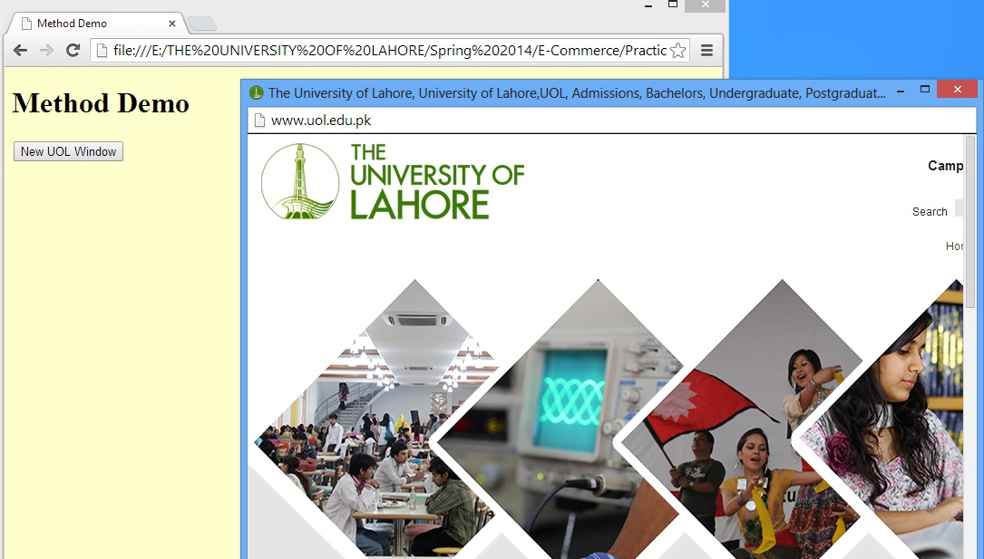

Slide 21
The main code segment that goes between the <SCRIPT>, </SCRIPT> tags in the HEAD:
function uolWindow() { window.open(“http://www.uol.edu.pk/”); }
The JavaScript code included as an attribute of the “New UOL Window” button:
onClick=“uolWindow()”
argument
method
different event handler

Slide 22
Retrieving an element by ID
var myElement = document.getElementById(“abc”);
html
head
body
title
h1
p
ul id =“abc”
li
li
li

Slide 23
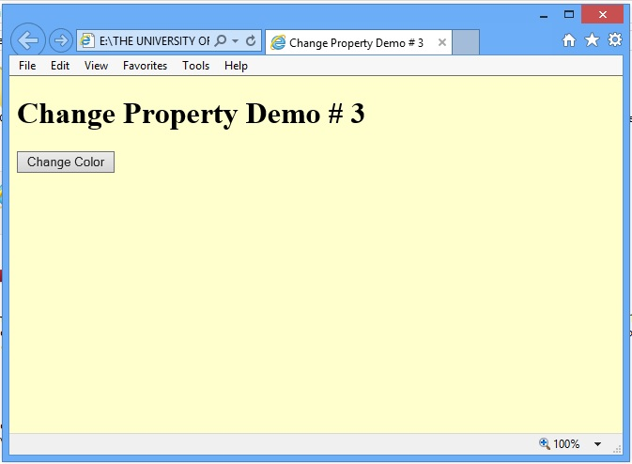

Slide 24
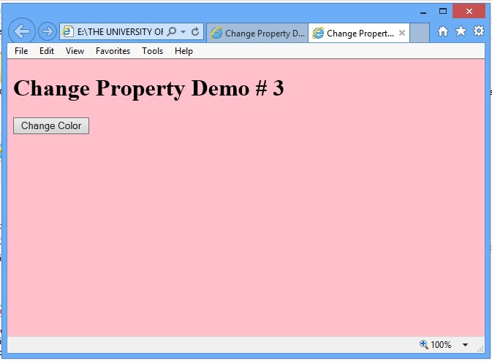

Slide 25
The main code segment that goes between the <SCRIPT>, </SCRIPT> tags in the HEAD:
function changeBgcolor() { window.document.bgColor = “pink”; }
The JavaScript code included as an attribute of the “Change Color” button:
onMouseOver=“changeBgcolor()”
new value
property

Slide 26
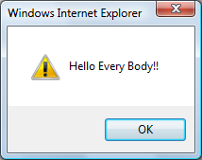
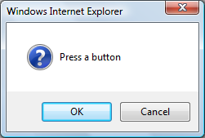
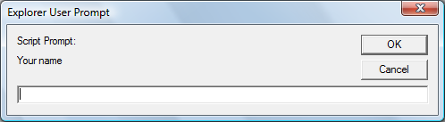
Popup Boxes
Alert Box
window.alert(“Hello Every body!!");
Confirm Box
window.confirm("Press a button");
Prompt Box
window.prompt(“Your name","")

Slide 27
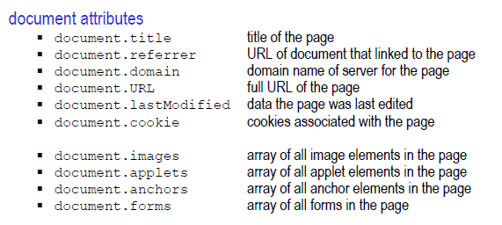
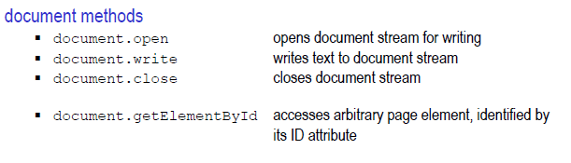

Slide 28
JavaScript Data Types
Unlike in C, C++ and Java, there are no explicit data types in JavaScript
Nevertheless, it recognizes & distinguishes among the following types of values:
Numbers, e.g., 23, 4.3, -230, 4.4e-24
Booleans, e.g., true, false
Strings, e.g., “hello”, “What’s the time?”
Undefined

Slide 29
Variables
Variables give us the ability to manipulate data through reference instead of actual value
Variables are names assigned to values
Variables are containers that hold values (Example: Hotel guest name, Guest room no.)
Generally, the value of a variable varies during code execution (that is why the term “variable”!)

Slide 30
Example
With Variable
Without Variable
x is a variable
5 lines of code replacing 5 lines of code!
Why u
se variables?
x = 1;
while (x < 6) {
document.write (x);
x = x + 1;
}
document.write (“1”); document.write (“2”); document.write (“3”); document.write (“4”); document.write (“5”);

Slide 31
Declaring Variables
Many languages require that a variable be declared (defined) before it is first used
JavaScript allows variable declaration, it does not require it
Declaring Variables –
var height
var name, address, phoneNumber
Any variable in JavaScript can hold any type of value, and the that type can change midway through the program

Slide 32
Identifiers
Identifiers are names used by JavaScript to refer to variables ( as well as objects, properties, methods, and functions!)
An identifier must begin with an alphabetical character (a-z or A-Z) or the underscore “_” character
Subsequent characters can be an alphabetical (a-z or A-B) or numeric character (0-9) or an underscore
Don’t not name variables with keywords like While
Wrong
1stStreet
number One
5
test@gmail
Right
Street1
numberOne

Slide 33
Elements of JavaScript Statements
b = 2 ;
sum = sum + 49 ;
name = “Bhola” + “ Continental” ;
x = Math.floor ( x ) ;
Identifiers
Operators
Literals
Punctuation

Slide 34
JavaScript Operators
Operators operate on operands to achieve the desired results
JavaScript has numerous operators, classified in many categories. We will look at only a few of them belonging to the following categories:
Assignment operators -- Arithmetic operators
Comparison operators -- String operators
Logical operators
We’ll look at a few more during future lectures, but understand that there are many more. Even you text book does not cover all of them!

Slide 35
Example
if ( x != 0 )
result = y / x;
else
result = “not defined”;

Slide 36
Logical Operators Operate on Boolean expressions or variables
The “AND (&&)” Logical Operator
if ( (pitch == “hard”) && (bowler == “fast”) )
myStatus = “Pulled muscle”;
The value of the variable myStatus will be set to “Pulled muscle” if both
a && b AND True if both are true
a || b OR True of either or both are true
!a NOT True if a is false
of the conditions are true

Slide 37
Example
if ( x || y )
document.write (“Either or both are true”);
else
document.write (“Both are false”);

Slide 38
if … else: Example 6
if ( grade == “A” )
points = 4.0 ;
else {
if ( grade == “B” )
points = 3.0 ;
else {
if ( grade == “C” )
points = 2.0 ;
else {
if ( grade == “D” )
points = 1.0 ;
else
points = 0.0 ;
}
}
}

Slide 39
switch: Example 1
switch ( grade ) {
case “A” :
points = 4.0 ;
break ;
case “B” :
points = 3.0 ;
break ;
case “C” :
points = 2.0 ;
break ;
case “D” :
points = 1.0 ;
break ;
default :
points = 0.0 ;
}
A colon following the case label is required
The expression enclosed in parentheses is evaluated and matched with case labels
This is a case label
This ‘break’ statement is the exit point
The ‘default’ statement acts like the ‘else’ clause in the ‘if…else’ structure

Slide 40
for: Example
for ( x = 99 ; x < 6000 ; x = x + 1 ) {
document.write ( x ) ;
}
=============
for ( x = 6000 ; x > 0 ; x = x - 1 )
{
document.write ( x ) ;
}
How many iterations would this ‘for’ loop run for?

Slide 41
Decimal to Binary Conversion in JavaScript
The condition enclosed in parentheses
x = 75 ; // x is the decimal number
y = “” ; // y is the binary equivalent
while ( x > 0 ) {
remainder = x % 2 ;
quotient = Math.floor( x / 2 ) ;
y = remainder + y ;
x = quotient ;
}
document.write( “y = ” + y ) ;

Slide 42
student = new Array( 4 ) ; //array declaration
student[ 0 ] = “Waseem” ;
student[ 1 ] = “Waqar” ;
student[ 2 ] = “Saqlain” ;
student[ 3 ] = “Daanish” ;
for ( x = 0 ; x < 4 ; x = x + 1 ) {
document.write( student[ x ] ) ;
}
Can you see the advantage of using arrays along with the ‘for’ loop?

Slide 43
Arrays in JavaScript
In JavaScript, arrays are implemented in the form of the ‘Array’ object
The key property of the ‘Array’ object is ‘length’, i.e the number of elements in an array
Two of the key ‘Array’ methods are:
reverse( )
sort( )
Elements of an array can be of any type; you can even have an array containing other arrays

